Slide 1
Understanding “Position” in Welding
Walter J. Sperko, P. E.
Sperko Engineering Services, Inc.
4803 Archwood Dr.
Greensboro, NC 27406
www.sperkoengineering.com
sperko@asme.org
336-674-0600
FAX 336-674-0202

Slide 2
This presentation posted on Sperkoengineering.com
The primary purpose of this presentation is twofold:
Make sure that code users understand the difference between testing positions and production welding positions
Help users understand how to read the figures that define production welding positions shown on the next page.

Slide 3
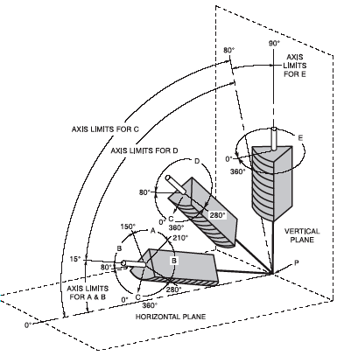
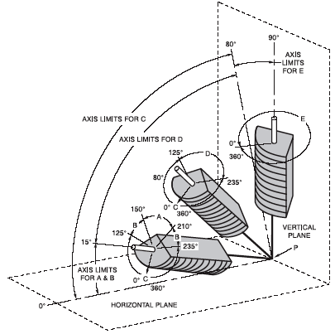
Production Welding Positions
Groove Welds
Fillet Welds

Slide 4
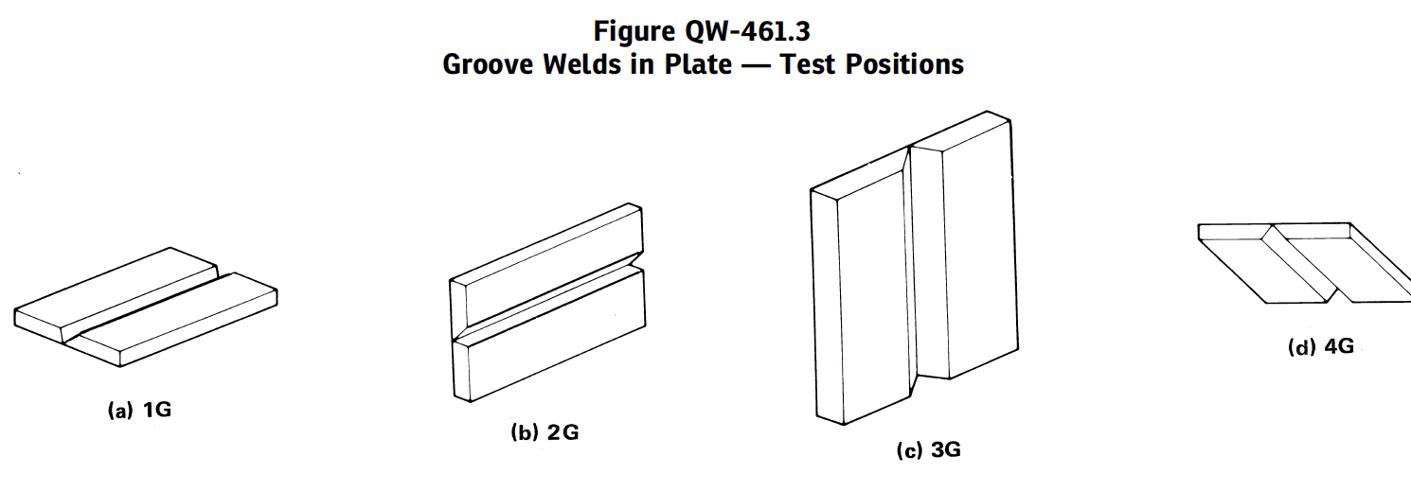
Standard Test Positions

Slide 5
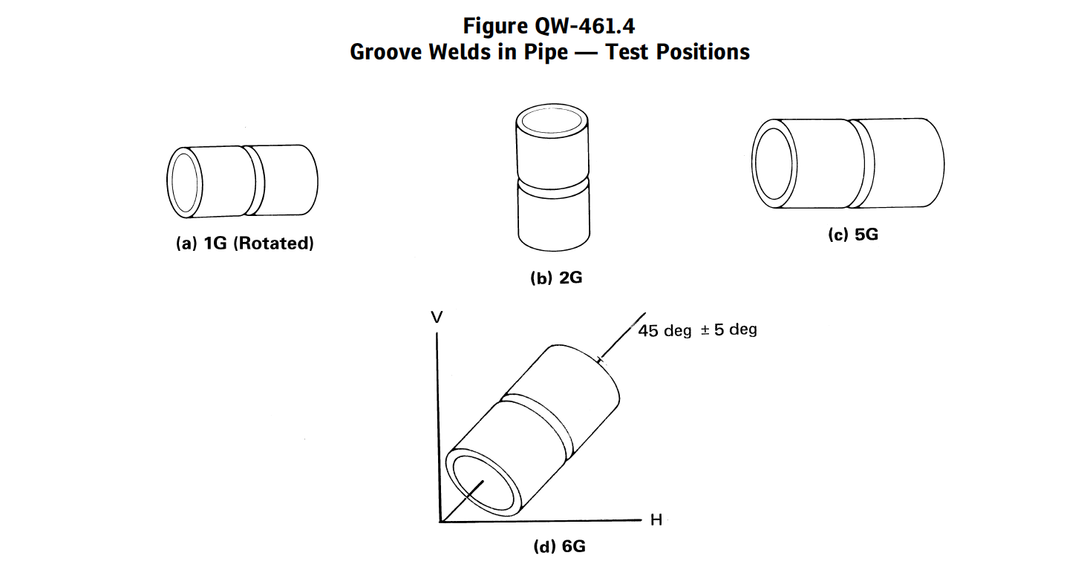
Standard Test Positions

Slide 6
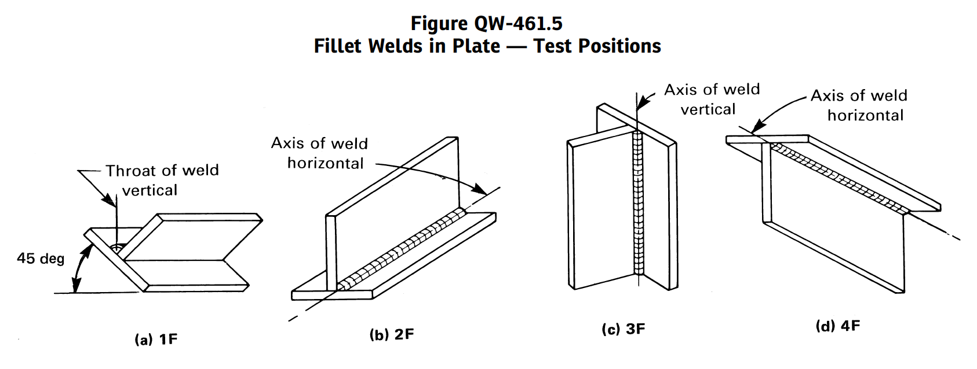
Standard Test Positions

Slide 7
Standard Testing Positions
Test positions are discreetly defined positions of test coupons that are used when mostly when testing welders. These positions have tolerance of ±15° from the defined horizontal planes and ±5° from a defined vertical or inclined plane. See QW-120

Slide 8
Testing Position 1G/PA
±15°
Weld Axis Horizontal
±15°
Plate Horizontal
Designations PA, PB, PD, etc. are the comparable
ISO 6947 equivalent posotioons

Slide 9
Test Position 2G/PC
Weld Axis Horizontal
±15°
±15°
Plates Vertical

Slide 10
Test Position 3F/PF or PG
±15°

Slide 11
Test Position 6G/HL045 or JL045
45°± 5°

Slide 12
Test Positions are Discreetly Defined
Because of tolerance limits on test positions, positions in between test positions are undefined!
That is, a weld that is inclined 22° uphill and rotated 36° about its axis has no “G” or “F” position. Such a position, however, may be encountered during production welding.
Production welding positions, therefore, need to be defined contiguously.

Slide 13
Test Positions Qualify Welders for Specific Welding Positions
Test Positions ↓ Welding Positions
Translations from test positions to welding positions are made in the construction codes. QW-461.9 is typical.

Slide 14
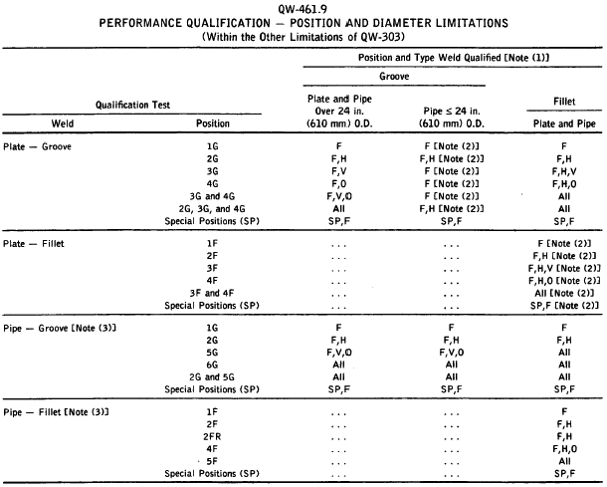
Test Positions ↓ Welding Positions

Slide 15
Welding Positions
Note to table:
(1) Positions of welding as shown in QW-461.1 and QW-461.2
F = Flat
H = Horizontal
V = Vertical
O = Overhead
(2) Pipe 2-7/8 in outside diameter and over.

Slide 16
Welding positions for groove welds are defined by the following diagram. NOTE Welding Position Diagrams are contiguous.

Slide 17
Welding Positions for Groove Welds

Slide 18
Tabulation showing transition points between welding positions
Tabulation of Positions of Groove Welds
Position Diagram Reference Inclination of Axis Rotation of Face
Flat A 0 to 15° 150 to 210°
Horizontal B 0 to 15° 80 to 150°
210 to 280°
Overhead C 0 to 80° 0 to 80°
210 to 360°
Vertical D 15 to 80° 80 to 280°
E 80 to 90° 0 to 360°
How this table and the diagram on the previous page work are shown in the following diagrams

Slide 19
Let’s start with the Flat Position

Slide 20
Welding Positions
Tabulation of Positions of Groove Welds
Position Diagram Reference Inclination of Axis Rotation of Face
Flat A 0 to 15° 150 to 210°
Horizontal B 0 to 15° 80 to 150°
210 to 280°
Overhead C 0 to 80° 0 to 80°
210 to 360°
Vertical D 15 to 80° 80 to 280°
E 80 to 90° 0 to 360°
How this table and the diagram on the previous page work are shown in the following diagrams

Slide 21
Flat Positions Axis Inclination
15°

Slide 22
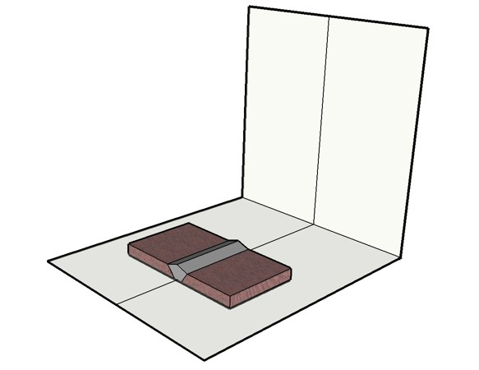
Start at Nominal Flat Position
Face of weld is up

Slide 23
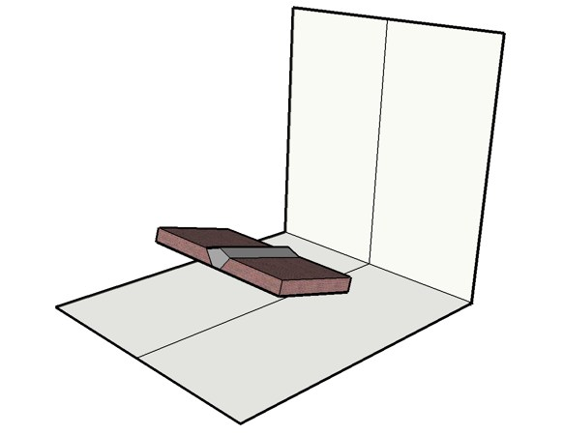
Flat Upward Inclined Limit
Weld may
incline upward
to a limit of 15°
15°

Slide 24
Flat Upward Inclined Limit
But the welder
could be traveling
down the incline. . .
15°

Slide 25
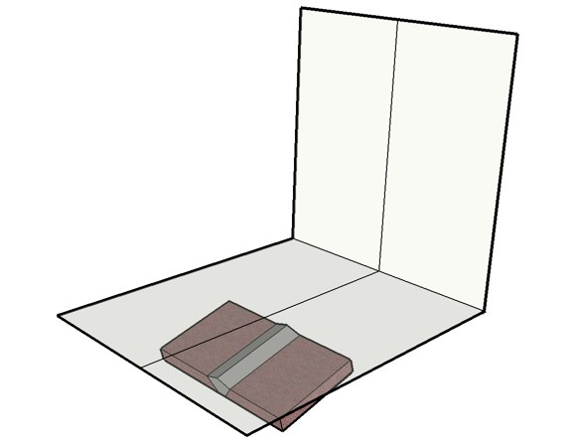
Flat Downward Limit Is Implied
15°

Slide 26
Welding Positions
Tabulation of Positions of Groove Welds
Position Diagram Reference Inclination of Axis Rotation of Face
Flat A 0 to 15° 150 to 210°
Horizonta B 0 to 15° 80 to 150°
210 to 280°
Overhead C 0 to 80° 0 to 80°
210 to 360°
Vertical D 15 to 80° 80 to 280°
E 80 to 90° 0 to 360°
How this table and the diagram on the previous page work are shown in the following diagrams

Slide 27
Flat Position --Rotation About Axis
150°
180°
210°
30°
30°
0°

Slide 28
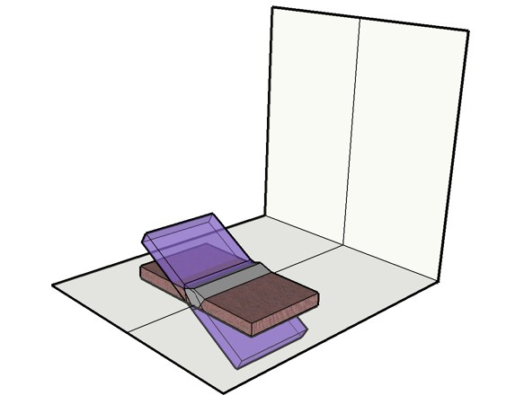
Flat Rolled Limit Clockwise
180°
210°
30°

Slide 29
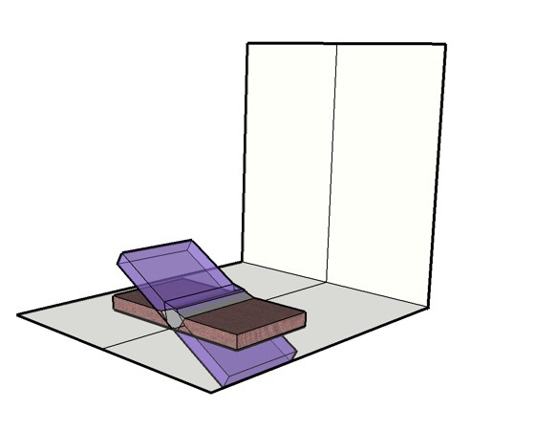
Flat Rolled Limit Clockwise
Equivalent to
rotating
The plate 30°
30°
210°
180°

Slide 30
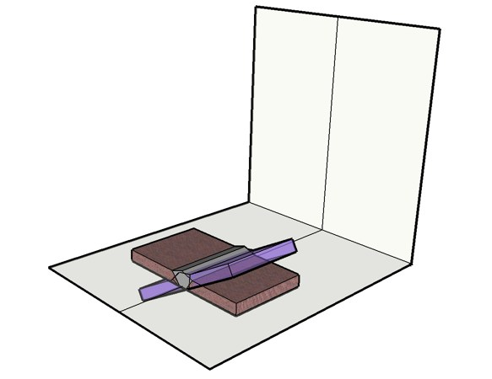
Flat Rolled Limit Counterclockwise
150°
180°
30°

Slide 31
Flat Rotated Limits Not Considering Inclination
60°

Slide 32
Welding Positions
Tabulation of Positions of Groove Welds
Position Diagram Reference Inclination of Axis Rotation of Face
Flat A 0 to 15° 150 to 210°
Horizonta B 0 to 15° 80 to 150°
210 to 280°
Overhead C 0 to 80° 0 to 80°
210 to 360°
Vertical D 15 to 80° 80 to 280°
E 80 to 90° 0 to 360°
How this table and the diagram on the previous page work are shown in the following diagrams

Slide 33
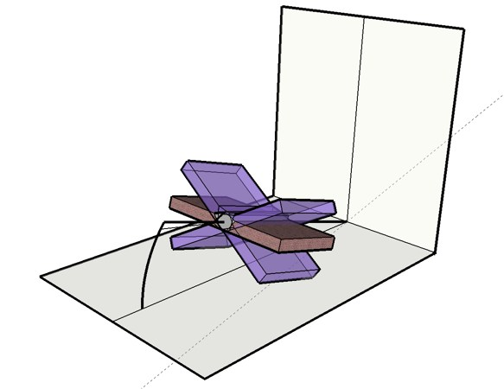
Flat Uphill Limit Rotated
15°
60°

Slide 34
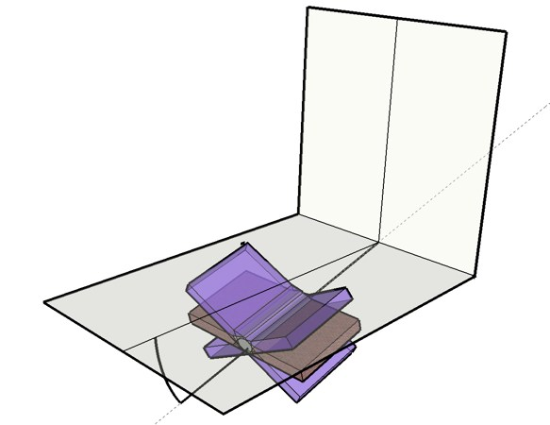
Flat Downhill Limit Rotated
15°

Slide 35
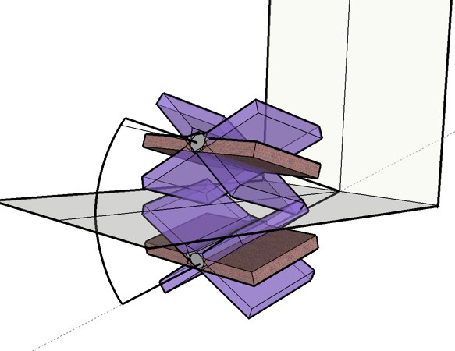
Composite Flat Position Ranges
60°
30°

Slide 36
Compare this range to 1G. . .

Slide 37
Testing Position 1G/PA
±15°
Weld Axis Horizontal
±15°
Plate Horizontal

Slide 38
Flat ≠ 1G !!!!

Slide 39
Welding Positions
Tabulation of Positions of Groove Welds
Position Diagram Reference Inclination of Axis Rotation of Face
Flat A 0 to 15° 150 to 210°
Horizontal B 0 to 15° 80 to 150°
210 to 280°
Overhead C 0 to 80° 0 to 80°
210 to 360°
Vertical D 15 to 80° 80 to 280°
E 80 to 90° 0 to 360°
How this table and the diagram on the previous page work are shown in the following diagrams

Slide 40
Horizontal Position Axis Inclined
15°

Slide 41
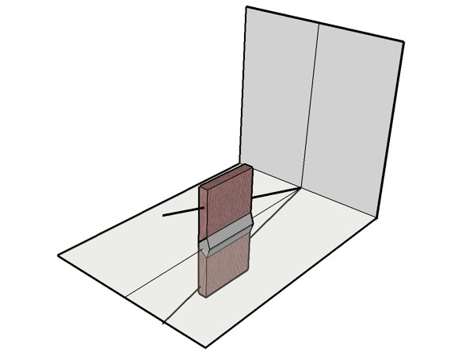
Basic Horizontal Position

Slide 42
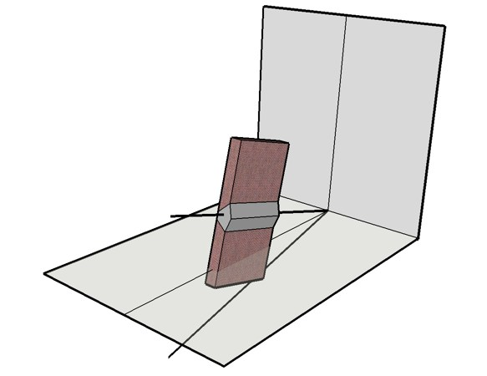
Horizontal Position Uphill Inclined Limit
15°

Slide 43
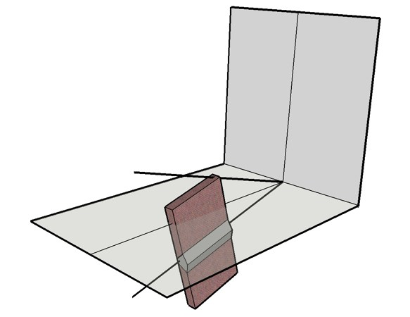
Horizontal Position Downhill Inclined Limit
15°

Slide 44
Welding Positions
Tabulation of Positions of Groove Welds
Position Diagram Reference Inclination of Axis Rotation of Face
Flat A 0 to 15° 150 to 210°
Horizontal B 0 to 15° 80 to 150°
210 to 280°
Overhead C 0 to 80° 0 to 80°
210 to 360°
Vertical D 15 to 80° 80 to 280°
E 80 to 90° 0 to 360°
How this table and the diagram on the previous page work are shown in the following diagrams

Slide 45
Horizontal Position Rotated
150°
210°
70° range
70° Range
80°
280°

Slide 46
Start at the Flat Rolled Limits
180°
210°
30°
Let’s go to an
end view. . . .

Slide 47
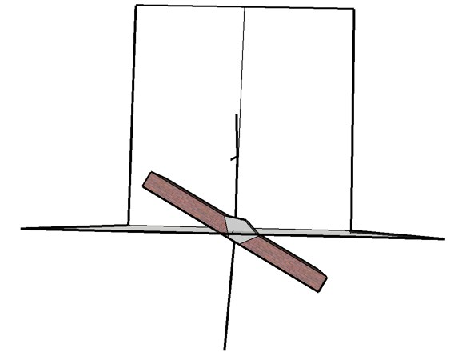
Horizontal End View
Horizontal starts where
Flat ends. . . .
210°
30°

Slide 48
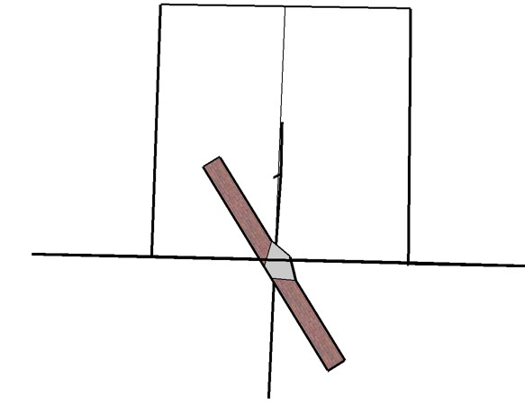
Horizontal Rotates to where the plate is perpendicular to the ground
Horizontal rotates
clockwise . .
30°

Slide 49
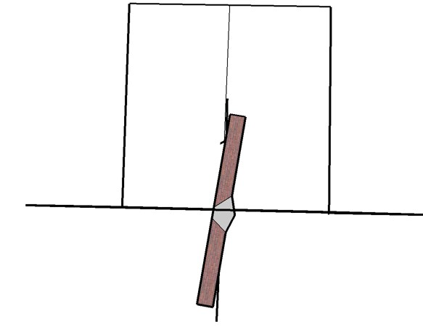
Horizontal Position Rotated Limit
Horizontal ends
here. . . .
90°
10°
30°
280°

Slide 50
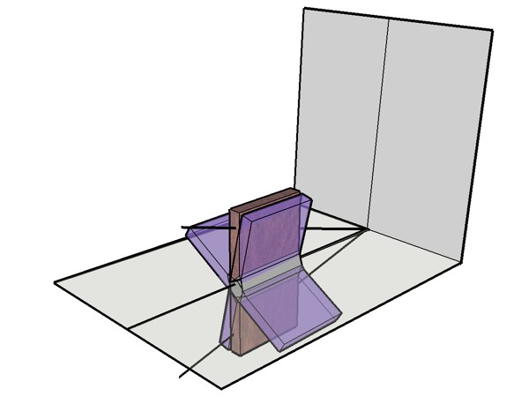
Non-inclined Horizontal Position Limits
Starts with plate
Rotated 30°
70°

Slide 51
Non-inclined Horizontal Position Limits
Finishes with plate
Rotated 10° beyond
perpendicular
70°

Slide 52
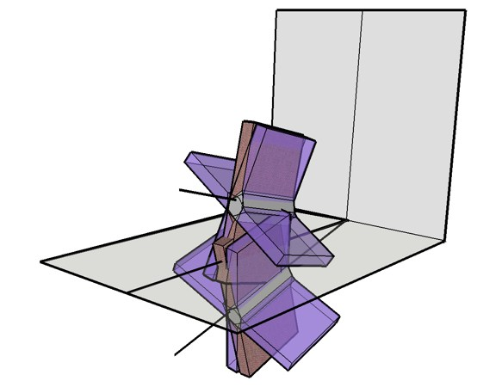
Composite Horizontal Position Limits
15°
15°

Slide 53
Compare Horizontal to 2G

Slide 54
Test Position 2G/PC
Weld Axis Horizontal
±15°
±15°
Plates Vertical

Slide 55
Horizontal ≠ 2G!!!!

Slide 56
Overhead Position
80°
280°
160° range

Slide 57
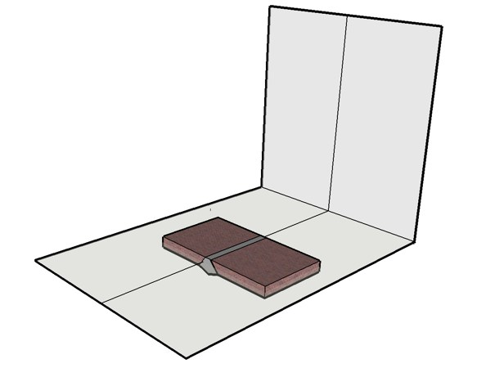
Basic Overhead
Face of weld
is overhead!!!
0°

Slide 58
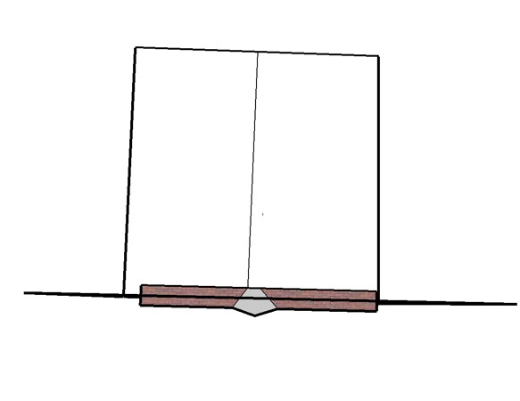
Basic Overhead End View
Face of weld
is overhead
0°

Slide 59
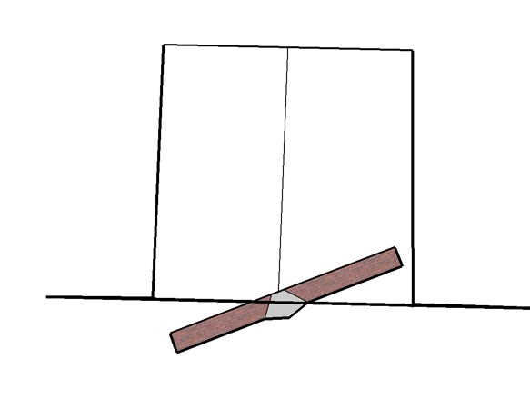
Overhead Partial Rotation End View
Face of weld
is overhead
0°

Slide 60
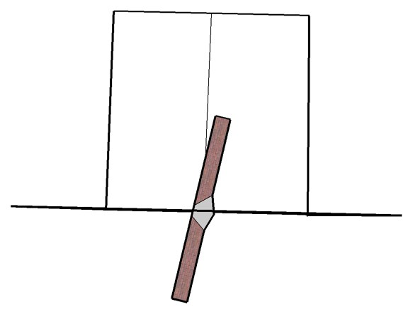
Overhead Maximum Rotation End View
Face of weld on
This side
280°
0°

Slide 61
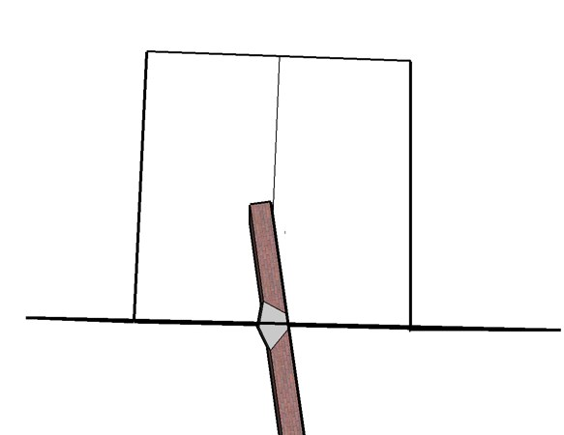
Overhead Maximum Opposite Rotation End View
Face of weld on
This side
80°
280°
0°

Slide 62
Same Rotation in Isometric View

Slide 63
Basic Overhead
Face of weld
is overhead
0°

Slide 64
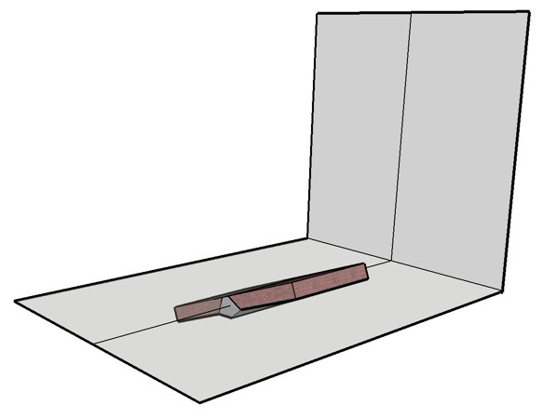
Overhead Partial Rotation Isometric View
Face of weld
is overhead
0°

Slide 65
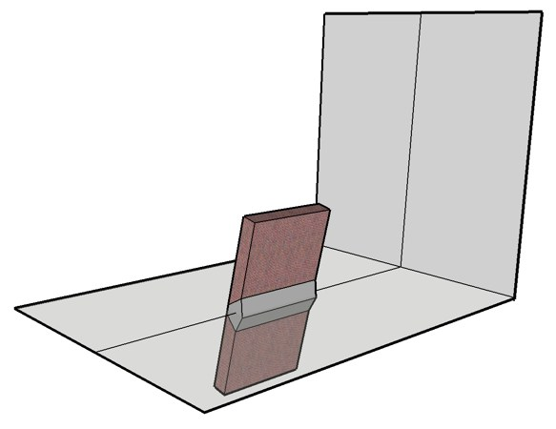
Overhead Maximum Rotation Isometric View
Face of weld
On this side
280°
0°

Slide 66
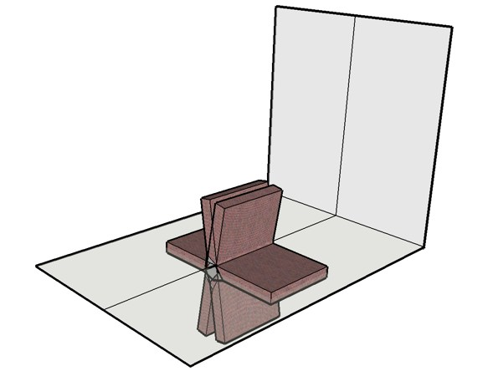
Overhead Maximum Opposite Rotation Isometric View
Face of weld
is on this side
80°
280°
0°

Slide 67
Overhead Position Axis Inclination
80° range
80°
280°
160° range

Slide 68
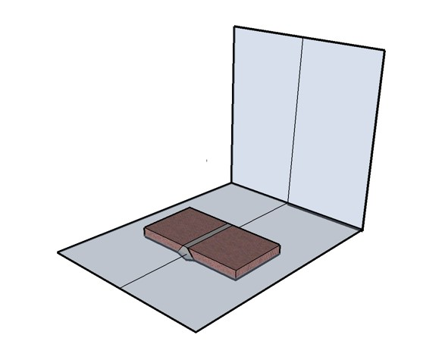
Basic Overhead for Inclined Axis
Face of weld
is overhead
0°

Slide 69
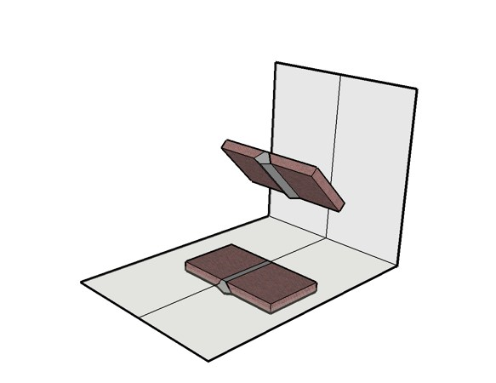
Overhead Inclined Axis Rotation
0°
0°

Slide 70
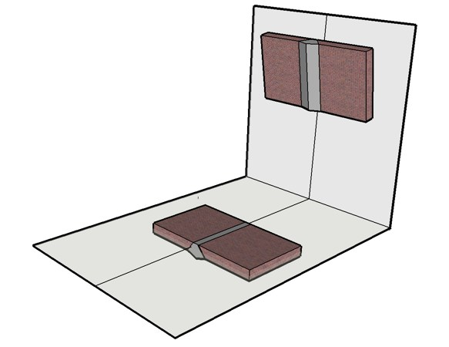
Overhead Inclined Axis Limit
80°
0°

Slide 71
Overhead Inclined Axis Limit
Weld can rotate 360°
about vertical axis
while inclined 10°
forward tilt.
80°
0°

Slide 72
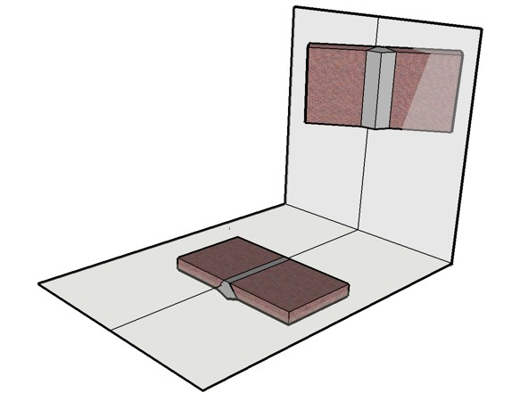
Overhead Inclined Axis Limit
10°
Weld can rotate about
The vertical axis
0°

Slide 73
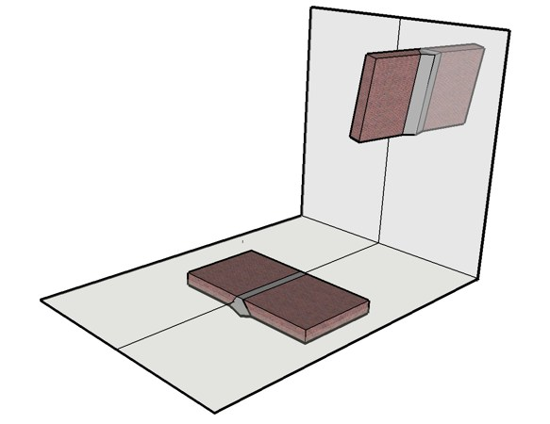
Overhead Inclined Axis Limit
10°
Weld can rotate about
The vertical axis
0°

Slide 74
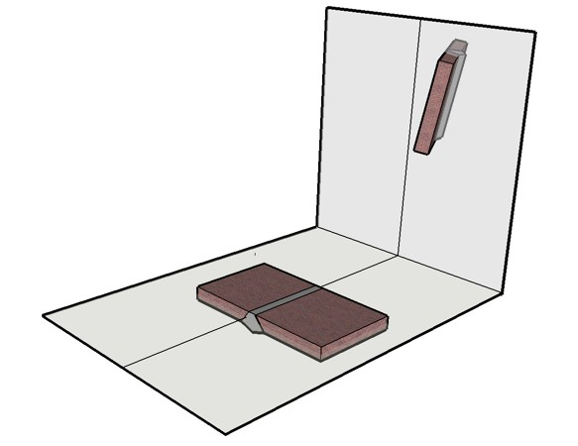
Overhead Inclined Axis Limit
10°
Weld can rotate about
The vertical axis
0°

Slide 75
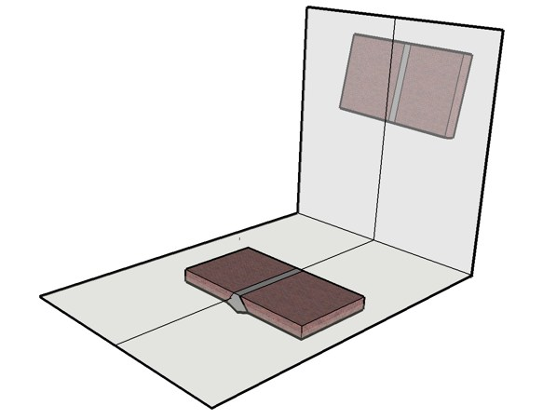
Overhead Inclined Axis Limit
10°
Weld can rotate about
The vertical axis
0°

Slide 76
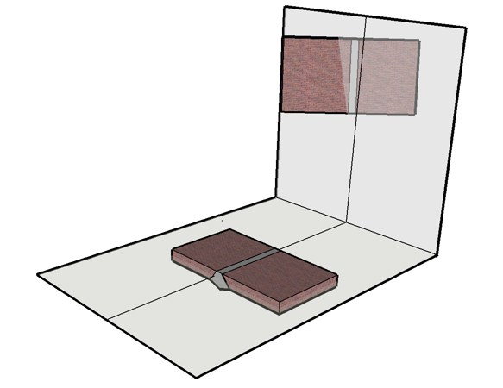
Overhead Inclined Axis Limit
10°
Weld can rotate about
The vertical axis
0°

Slide 77
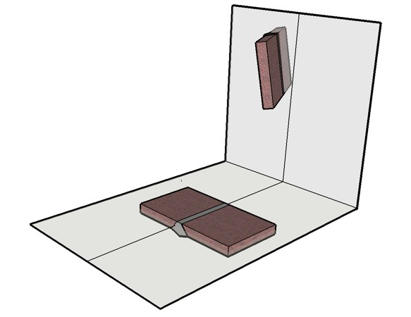
Overhead Inclined Axis Limit
10°
Weld can rotate about
The vertical axis
0°

Slide 78
Overhead Inclined Axis Limit
10°
Weld ends up back
Where it started!
0°

Slide 79
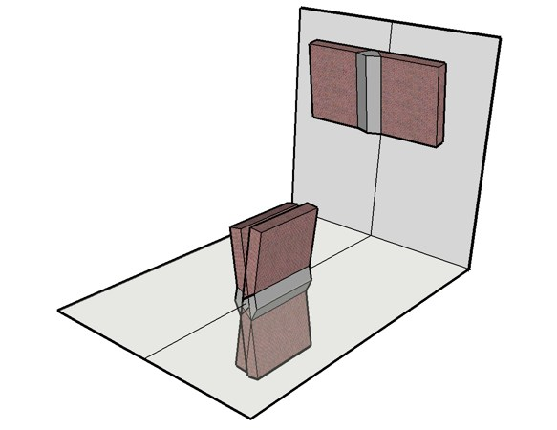
Composite Overhead Position Limits
360°
10°
80°
80°
0°
0°
280°

Slide 80
Overhead ≠ 4G !!!!

Slide 81
Vertical Position Part 1
80°
65° Range of Inclination
From 15 to 80°.
Face of weld is up
15°

Slide 82
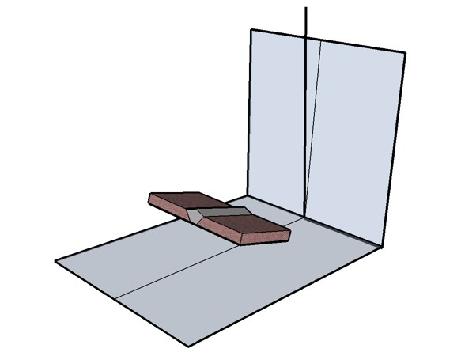
Vertical Position Part 1
Range of inclination
Starts at 15°
Face of weld is up
15°

Slide 83
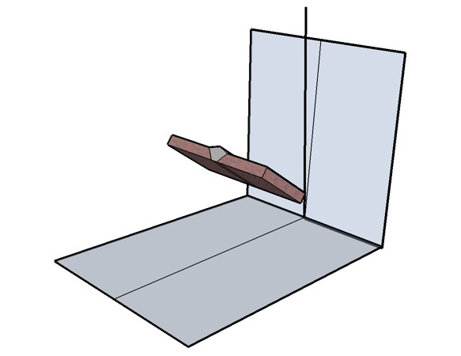
Vertical Position Part 1
Range of inclination
continues upward. . .
Greater than 15°

Slide 84
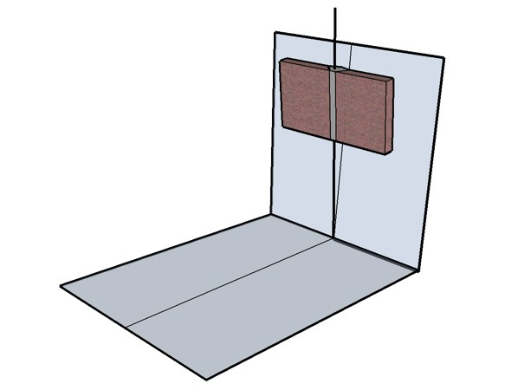
Vertical Position Part 1
Until reaching 80°
80°

Slide 85
Vertical Position Part 2
When the “E” portion
of the
diagram is reached
80°

Slide 86
Vertical Position Part 2
80°
The “E” portion
of the diagram --
360° Rotation
About vertical axis

Slide 87
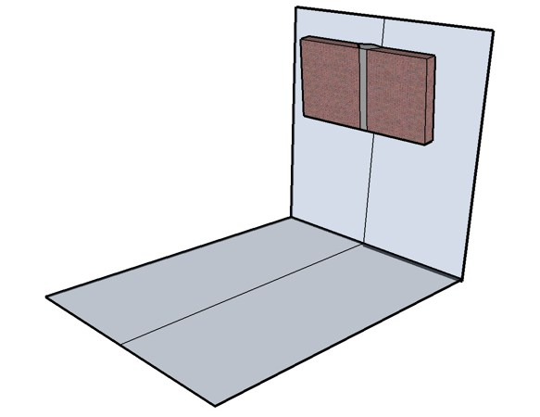
Vertical Position Part 2
The “E” portion of the
diagram begins here. .
80°

Slide 88
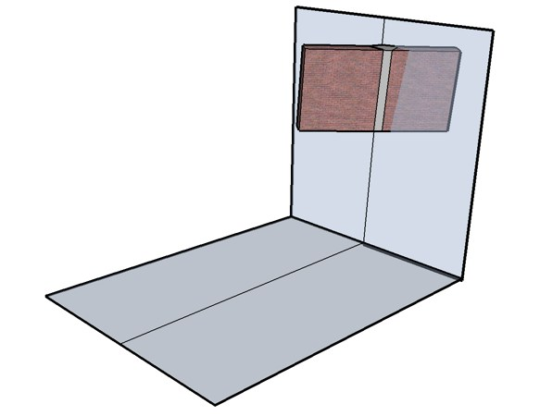
Vertical Position Part 2
Partial rotation about
Vertical axis

Slide 89
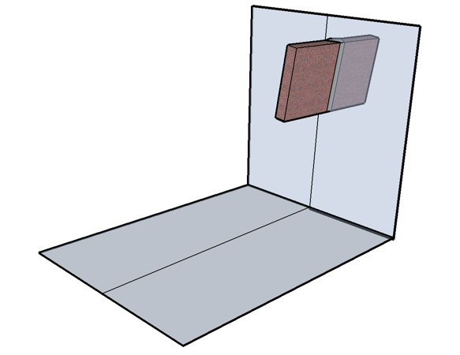
Vertical Position Part 2
More rotation about
Vertical axis

Slide 90
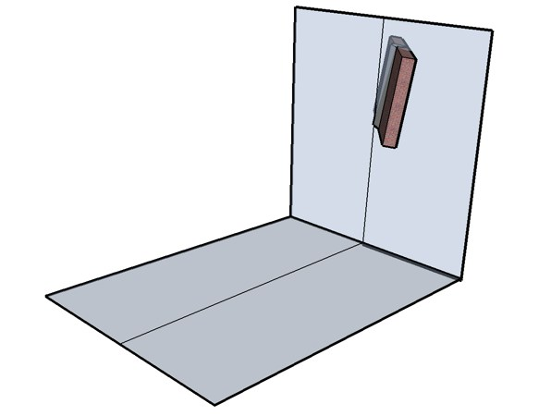
Vertical Position Part 2
Even more rotation about
Vertical axis

Slide 91
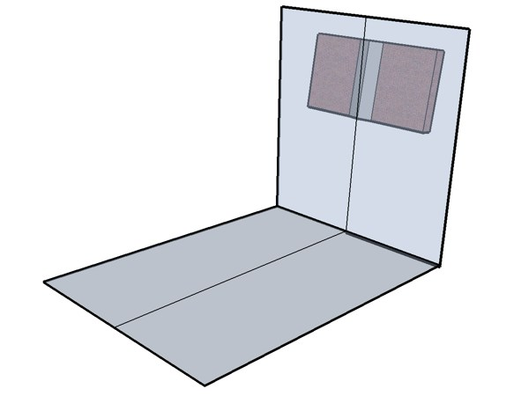
Vertical Position Part 2
Rotated 180° about
Vertical axis

Slide 92
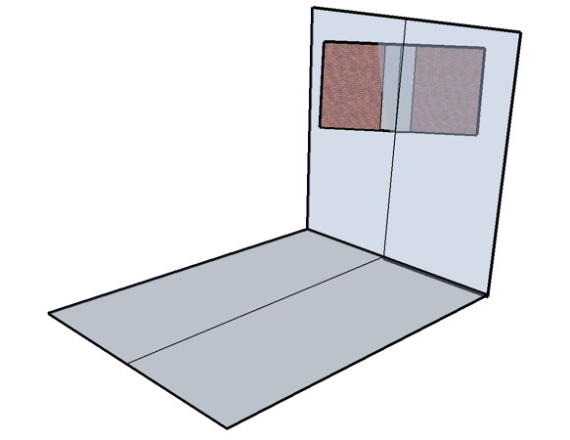
Vertical Position Part 2
Continuing Rotation about
Vertical axis

Slide 93
Vertical Position Part 2
Continuing Rotation about
Vertical axis

Slide 94
Vertical Position Part 2
Continuing Rotation about
Vertical axis

Slide 95
Vertical Position Part 2
360° of Rotation about
Vertical axis completed

Slide 96
Vertical Position Part 3
200° Range
of Rotation
80°
280°

Slide 97
Vertical Position Part 3
Start here with inclination
Uphill or Downhill 15°
Face of weld upward
15°

Slide 98
Vertical Position Part 3
Rotate face while holding
Inclination constant
15°

Slide 99
Vertical Position Part 3
Continue rotating with
Inclination constant
15°

Slide 100
Vertical Position Part 3
Rotated to vertical limit
Inclination constant
15°
280°

Slide 101
Vertical Position Part 3
Return to starting position
Uphill or Downhill 15°
Face of weld upward
15°

Slide 102
Vertical Position Part 3
Rotate face of weld
Opposite direction
Inclination Constant 15°
15°

Slide 103
Vertical Position Part 3
Continue rotating
Opposite direction
Inclination Constant 15°
15°

Slide 104
Vertical Position Part 3
Plate near vertical
Inclination Constant 15°
15°

Slide 105
Vertical Position Part 3
Plate at vertical limit
of rotation.
Inclination Constant 15°
80°
15°

Slide 106
Vertical Position Part 3
200° Range of
Rotation inclined
Uphill or Downhill 15°
80°
15°
280°

Slide 107
Vertical Position Part 3
80°
200° Range of Rotation
Inclination angle
Increases
280°

Slide 108
Vertical Position Part 3
80°
200° Range of Rotation
Inclination angle
Increases more. . .
280°

Slide 109
Vertical Position Composite
360°
65°
200°
80°
280°
160° range

Slide 110
Welding Positions for Fillet Welds

Slide 111
Flat Fillet Weld

Slide 112
Horizontal Fillet Weld

Slide 113
Welding Positions for Fillet Welds

Slide 114
Welding Positions for Fillet Welds
Tabulation of Positions of Fillet Welds
Position Diagram Reference Inclination of Axis Rotation of Face
Flat A 0 to 15° 150 to 210°
Horizontal B 0 to 15° 125 t0 150°
210 to 235°
Overhead C 0 to 80° 0 to125°
235 to 360°
Vertical D 15 to 80° 125 to 235°
E 80 to 90° 0 to 360°

Slide 115
Welding Positions for Fillet Welds
The Horizontal Range
Is smaller for fillet welds
Than it is for groove welds

Slide 116
Welding Positions for Groove Welds

